Slide 1
Queueing theory
Unit V
Queuing System , performance
&
Markov chain

Slide 2
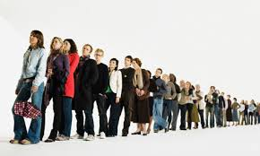
Introduction
The first queueing theory problem was considered by Erlang in 1908 who looked at how large a telephone exchange needed to be in order to keep to a reasonable value the number of telephone calls not connected because the exchange was busy (lost calls).

Slide 3
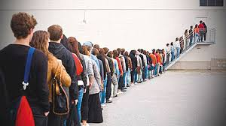
Queueing theory is the mathematical study of waiting lines, or queues.

Slide 4
Key elements of queuing systems
• Customer
refers to anything that arrives at a facility and requires service, e.g., people, machines, trucks, emails.
• Server
refers to any resource that provides the requested service, eg. repairpersons, retrieval machines, runways at airport.

Slide 5
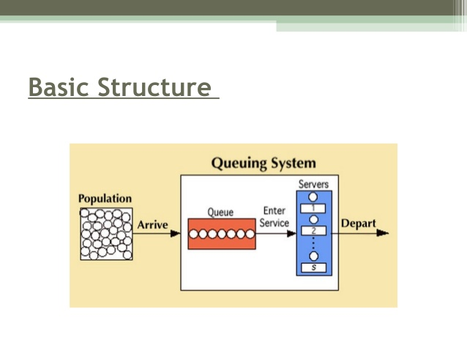

Slide 6
CHARACTERISTIC OF QUEUING SYSTEM
The Input or arrival-pattern
The Output or service-pattern
Queue Discipline
System Capacity
Service channels.

Slide 7
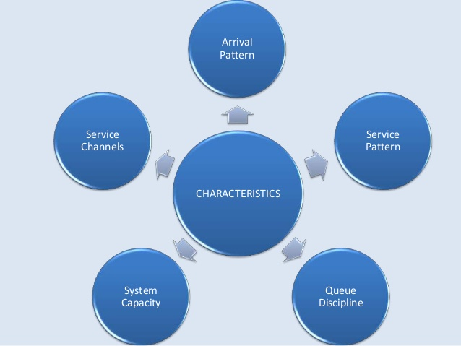
CHARACTERISTIC OF QUEUING SYSTEM

Slide 8
The input(arrival pattern)
The input describes the way in which customers arrive and join the system.
We deal with those queuing system in which the customers arrive in poisson fashion.
The mean arrival rate is
Interarrival time =1/ arrival rate

Slide 9
The output (Service Pattern)
The time taken by a server to service a customer is known as Service Time.
Number of servers and speed of service to be considered.
It is represented by µ

Slide 10
The queue discipline
It is a rule according to which customers are selected for service when a queue has been formed.
The most common disciplines are
1. FCFS[ First Come First Serve]
2. FIFO[ First In First Out]
3. LIFS [ Last Come First Serve]
4. SIRO[ Service in random Order]

Slide 11
Service capacity
Maximum number of customers that can be accommodated in the queue.
• Assumed to be of infinite capacity.

Slide 12
Service Channels
• Single channel queuing system
• Multi channel queuing system
• Single channel multi phase system
• Multi channel multi phase system

Slide 13
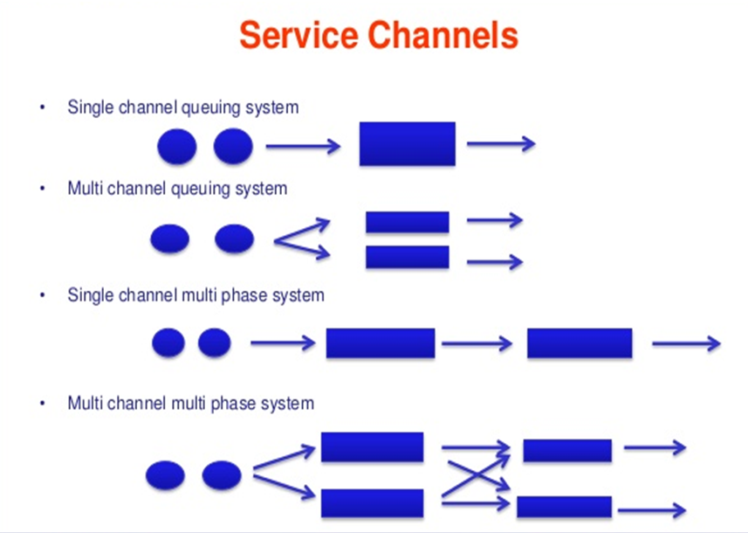

Slide 14
Customer’s behavior
The customers generally behave in the
following four ways.
Balking
A customer who leaves the queue because the queue is too long and he has no time to wait or has no sufficient waiting space.
Reneging
A waiting customer leaves the queue due to impatience.
Jockeying
Customers may jockey from one waiting line to another to their reasons.
Priority
Some customers are served before others regardless of their order to arrival.

Slide 15
Applications of Queuing Model
Telecommunications
• Traffic control
• Determining the sequence of computer operations.
• Predicting computer performance
• Health services (e.g.. control of hospital bed assignments)
• Airport traffic, airline ticket sales
• Layout of manufacturing systems.

Slide 16
BASIC POINTS
1. Customer(Arrival)
The arrival unit that requires some services to performed.
2. Queue:
The number of Customer waiting to be served.
3. Arrival Rate
The rate which customer arrive to the service station.
4. Service rate (µ)
The rate at which the service unit can provide service to
the customer
5. Utilization Ratio Or Traffic intensity ( λ /µ )
λ / µ > 1 Queue is growing without end.
λ / µ < 1 Length of Queue is go on diminishing.
λ /µ = 1 Queue length remain constant.

Slide 17
Transient & Steady State of the system
• When the operating characteristics are dependent on time, it is said to be a transient state.
• When the operating characteristics are independent of time, it is said to be a steady state.

Slide 18
Kendall Notation 1/2/3(/4/5/6)
Six parameters in shorthand
First three typically used, unless specified
Arrival Distribution
Service Distribution
Number of servers
Total Capacity (infinite if not specified)
Population Size (infinite)
Service Discipline (FCFS/FIFO)

Slide 19
Kendall Classification of Queuing Systems
The Kendall classification of queuing systems (1953) exists in several modifications.
The most comprehensive classification uses 6 symbols: A/B/s/q/c/p
where:
A is the arrival pattern (distribution of intervals between arrivals).
B is the service pattern (distribution of service duration).
s is the number of servers.
q is the queuing discipline (FIFO, LIFO, ...). Omitted for FIFO or if not specified.
c is the system capacity. Omitted for unlimited queues.
p is the population size (number of possible customers). Omitted for open systems.

Slide 20
Kendall Classification of Queuing Systems
These symbols are used for arrival and service patterns:
M is the Poisson (Markovian) process with exponential distribution of intervals or service duration respectively.
Em is the Erlang distribution of intervals or service duration.
D is the symbol for deterministic (known) arrivals and constant service duration.
G is a general (any) distribution.
GI is a general (any) distribution with independent random values.

Slide 21
Kendall Classification of Queuing Systems
Examples:
D/M/1 = Deterministic (known) input, one exponential server, one unlimited FIFO or unspecified queue, unlimited customer population.
M/G/3/20 = Poisson input, three servers with any distribution, maximum number of customers 20, unlimited customer population.
D/M/1/LIFO/10/50 = Deterministic arrivals, one exponential server, queue is a stack of the maximum size 9, total number of customers 50.

Slide 22
Simulation of Queuing Systems
Measures of system performance
The performance of a queuing system can be evaluated in terms of a number of response parameters, however the following four are generally employed.
Average number of customers in the queue or in the system
Average waiting time of the customers in the queue or in the system
System utilization
The cost of the waiting time & idle time
30

Slide 23
Simulation of Queuing Systems
Measures of system performance
The knowledge of average number of customers in the queue or in the system helps to determine the space requirements of the waiting entities. Also too long a waiting line may discourage the prospectus customers, while no queue may suggest that service offered is not of good quality to attract customers.
The knowledge of average waiting time in the queue is necessary for determining the cost of waiting in the queue.

Slide 24
Simulation of Queuing Systems
System Utilization
System Utilization that is the percentage capacity utilized reflects that extent to which the facility is busy rather than idle.
System utilization factor (s) is the ratio of average arrival rate (λ) to the average service rate (µ).
S= λ/µ in the case of a single server model S= λ/µn in the case of a “n” server model
The system utilization can be increased by increasing the arrival rate which amounts to increasing the average queue length as well as the average waiting time, as shown in fig 1. Under the normal circumstances 100% system utilization is not a realistic goal.

Slide 25
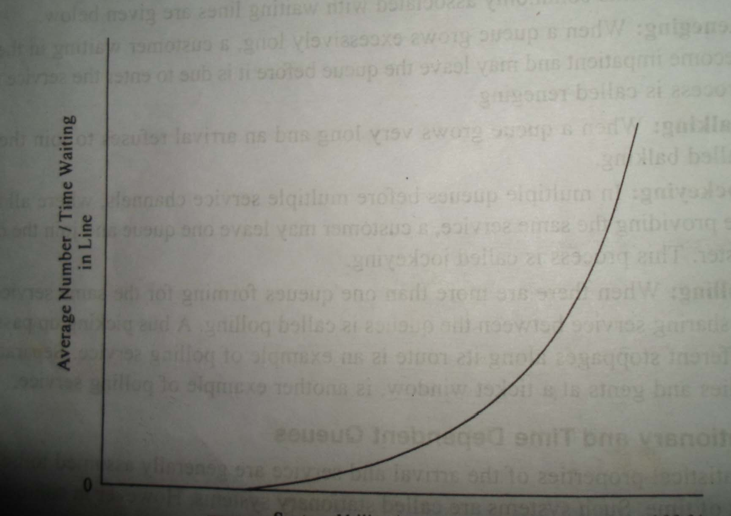
System Utilization
Fig 1
33

Slide 26
Time Oriented Simulation
A factory has large number of semiautomatic machines.On 50% of the working days none of the machines fail. On 30%of the days one machines fails and on 20%of the days two machines fail. The maintenance staff on the average puts 65% of the machines in order in one day, 30% in two days and remaining 5% in three days.
Simulate the system for 30 days duration and estimate the average length of queue, average waiting time and server loading that is the fraction of time for which server is busy.

Slide 27
Time Oriented Simulation
Solution:
The given system is a single server queuing model. The failure of the machines in the factory generates arrivals, while the maintenance staff is the service facility. There is no limit on the capacity of the system in other words on the length of waiting line. The population of machines is very large and can be taken as infinite.
Arrival pattern:
On 50%of the days arrival=0 On 30%of the days arrival=1 On 20%of the days arrival=2
Expected arrival rate=0*.5+1*.3+2*.2=0.7 per day.
Service pattern:
65% machines in 1 day
30% machines in 2 days
5% machines in 3 days

Slide 28
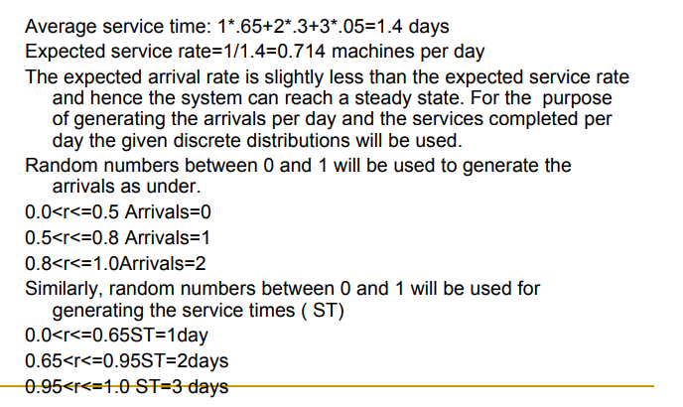
Time Oriented Simulation

Slide 29
Time Oriented Simulation
In the time-oriented simulation, the timer is advanced in fixed steps of time and at each step the system is scanned and updated.
The time is kept very small, so that not many events occur during this time.
All the events occurring during this small time interval are assumed to occur at the end of the interval.
At start of the simulation, the system that is the maintenance facility can assumed to be empty, with no machine waiting for repair.
On day 1, there is no machine in the repair facility.
On day 2 there are 2 arrivals, the queue is made 2.
Since service facility is idle, one arrival is put on service and queue becomes 1.
Server idle time becomes 1 day and the waiting time of customers is also 1 day. Timer is advanced by one day.
The service time, ST is decreased by one and when ST becomes zero facility becomes idle.
Arrivals are generated which come out to be 1, it is added to the
queue.

Slide 30
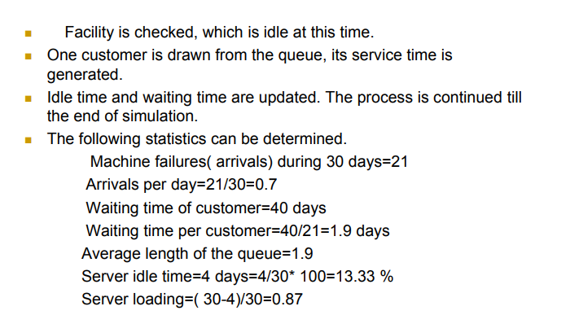
Time Oriented Simulation

Slide 31
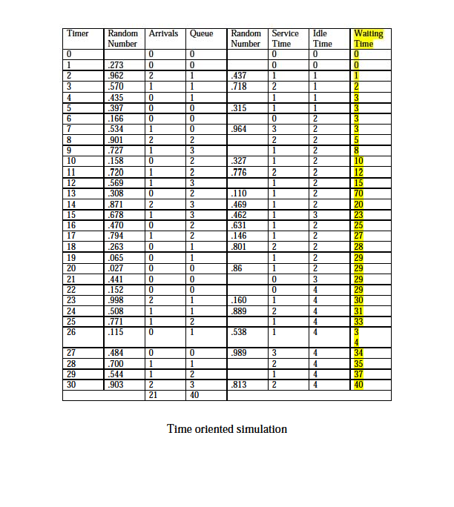

Slide 32
Simulation on queuing system
Tutorial
In a manufacturing system parts are being made at a rate of one every 6 minutes. They are two types A and B and are mixed randomly with about 10 percent of type B. A separate inspector is assigned to examine each type of parts. The inspection of a part takes a mean time of 4 minutes with a standard deviation of 2 minutes , but part B takes a mean time 20 minutes and a standard deviation of 10 minutes. Both inspectors reject about 10% of the parts they inspect. Simulate the system for total of 50 type A parts accepted and determine , idle time of inspectors and average time a part spends in system.

Slide 33
Markov Chains

Slide 34
Markov Chains
If the future states of a process are independent of the past and depend only on the present , the process is called a Markov process
A discrete state Markov process is called a Markov chain.
A Markov Chain is a random process with the property that the next state depends only on the current state.

Slide 35
Markov Chains
Since the system changes randomly , it is generally impossible to predict the exact state of the system in the future.
However, the statistical properties of the system’s future can be predicted.
In many applications it is these statistical properties that are important current state depends only the current state.
M/M/m queues can be modeled using Markov processes.
The time spent by the job in such a queue is Markov process and the number of jobs in the queue is a Markov chain.

Slide 36
Markov Chain
A simple example is the nonreturning random walk, where the walkers are restricted to not go back to the location just previously visited.

Slide 37
Markov Chains
Markov chains is a mathematical tools for statistical modeling in modern applied mathematics, information science

Slide 38
Why Study Markov Chains?
Markov chains are used to analyze trends and predict the future. (Weather, stock market, genetics, product success, etc.

Slide 39
Markov Chains
As we have discussed, we can view a stochastic process as sequence of random variables
{X₁,X₂,X₃,X₄,X₅,X₆,X₇, . . .}
Suppose that X₇ depends only on X₆, X₆ depends only on X₅, X₅ on X₄, and so forth. In general, if for all i,j,n,
P(X_{n+1} = j|x_{n} = i_{n}, x_{n−1} = i_{n−1}, . . . , x₀ = i₀) = P(X_{n+1} = j|X_{n} = i_{n}),
then this process is what we call a Markov chain.

Slide 40
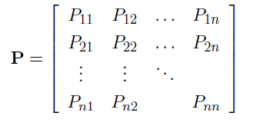
Markov Chains
The conditional probability above gives us the probability that a process in state i_{n} at time n moves to i_{n+1} at time n + 1.
•We call this the transition probability for the Markov chain.
If the transition probability does not depend on the time n, we have a stationary Markov chain, with transition probabilities
Now we can write down the whole Markov chain as a matrix P:

Slide 41
Markov Chains
The probability of going from state i to state j in n time steps is
and the single-step transition is
For a time-homogeneous Markov chain: and

Slide 42
Key Features of Markov Chains
A sequence of trials of an experiment is a
Markov chain if
the outcome of each experiment is one of a set of discrete states;
the outcome of an experiment depends only on the present state, and not on any past states;
the transition probabilities remain constant from one transition to the next.

Slide 43
Markov Chains
The Markov chain has network structure much like that of website, where each node in the network is called a state and to each link in the network a transition probability is attached, which denotes the probability of moving from the source state of the link to its destination state.

Slide 44
Markov Chains
The process attached to a Markov chain moves through the states of the networks in steps, where if a any time the system is in state i, then with probability equal to the transition probability from state i, to state j, it moves to state j.
We will model the transitions from one page to another in a web site as a Markov chain.
The assumption we will make , called Markov property, is that the probability of moving from source page to a destination page doesn’t depend on the route taken to reach the source.

Slide 45


Internet application
The PageRank of a webpage as used by Google is defined by a Markov chain.
It is the probability to be at page i in the stationary distribution on the following Markov chain on all (known) webpages. If N is the number of known webpages, and a page i has k_{i} links then it has transition probability
for all pages that are linked to and for all pages that are not linked to.
The parameter α is taken to be about 0.85

Slide 46
Internet application
Markov models have also been used to analyze web navigation behavior of users.
A user's web link transition on a particular website can be modeled using first- or second-order
Markov models and can be used to make predictions regarding future navigation and to personalize the web page for an individual user.

Slide 47
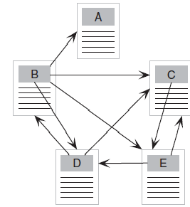
Example website to illustrate PageRank

Slide 48
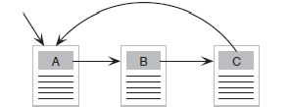
Example of a rank sink

Slide 49

Markov Process
Markov Property: The state of the system at time t+1 depends only on the state of the system at time t
Pr[X _{t +1} = x_{t +1} | X ₁ ☹ X _{t} = x₁ ☹ x_{t} ] Pr[X _{t +1} = x_{t} ]
= = x_{t +1} | X _{t}
X₂
X₁ X₃ X₄ X₅
Stationary Assumption: Transition probabilities are independent of time (t)
Pr[ X_{t +1} = b | X_{t} = a
= p_{ab}

Slide 50
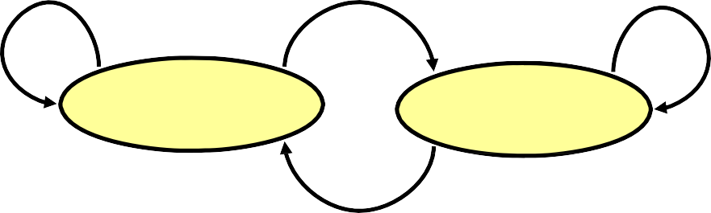
Markov Process
Simple Example
Weather:
raining today
40% rain tomorrow 60% no rain tomorrow
20% rain tomorrow 80% no rain tomorrow
not raining today
Stochastic FSM:
0.4
0.6
0.8
rain
no rain
0.2

Slide 51
Markov Process
Simple Example
Weather:
raining today
40% rain tomorrow 60% no rain tomorrow
not raining today
20% rain tomorrow 80% no rain tomorrow
The transition matrix:
⎛ 0.4 0.6 ⎞
Stochastic matrix:
P = ⎜
0.2
⎟
0.8
Rows sum up to 1
⎝
⎠
Double stochastic matrix:
Rows and columns sum up to 1

Slide 52


Markov Process
Coke vs. Pepsi Example
Given that a person’s last cola purchase was Coke, there is a 90% chance that his next cola purchase will
also be Coke.
If a person’s last cola purchase was Pepsi, there is an 80% chance that his next cola purchase will also be Pepsi.
transition matrix:
_{P =} ⎡0.9 0.1⎤
0.1
0.9
0.8
coke
pepsi
⎢0.2 0.8⎥
⎣ ⎦
0.2

Slide 53
Markov Process
Coke vs. Pepsi Example (cont)
Given that a person is currently a Pepsi purchaser, what is the probability that he will purchase Coke two purchases from now?
Pr[ Pepsi→?→Coke ] =
Pr[ Pepsi→Coke→Coke ] + Pr[ Pepsi→ Pepsi →Coke ] = ?
Step 1: Understand the states
There are only two states:
State | Meaning
C | Coke purchaser
P | Pepsi purchaser

Slide 54
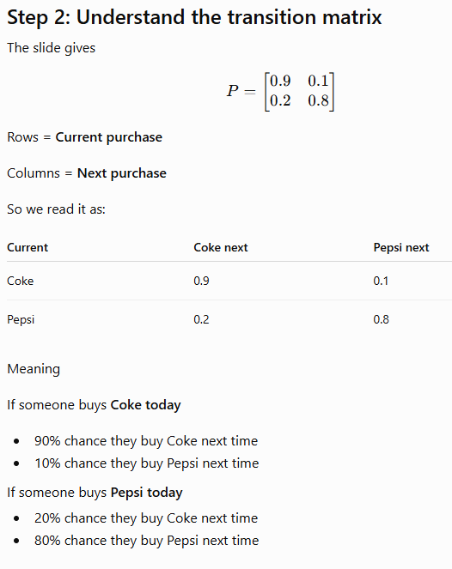

Slide 55
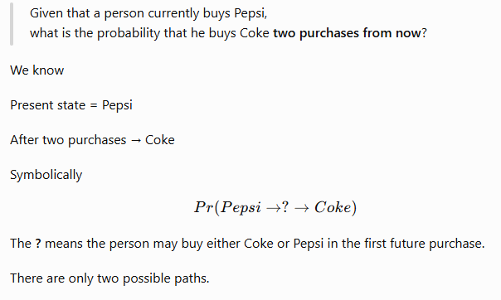

Slide 56
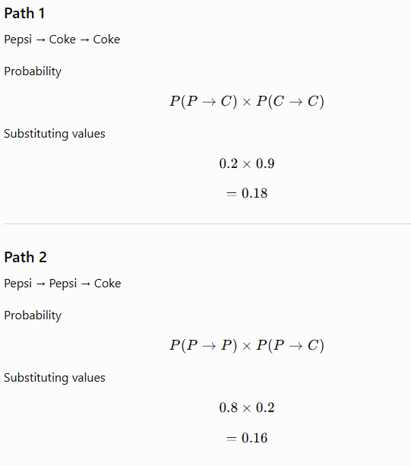

Slide 57
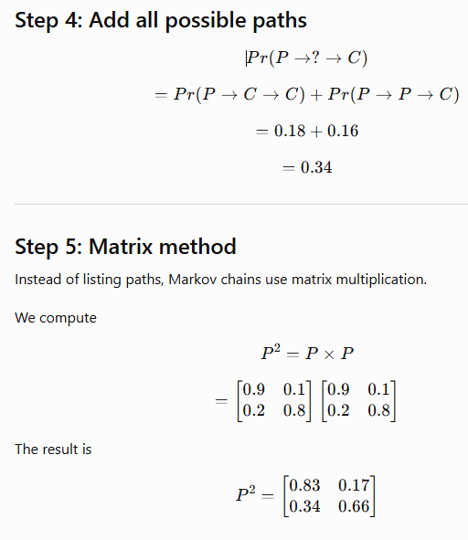

Slide 58
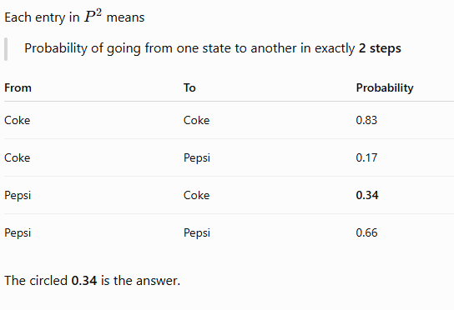

Slide 59
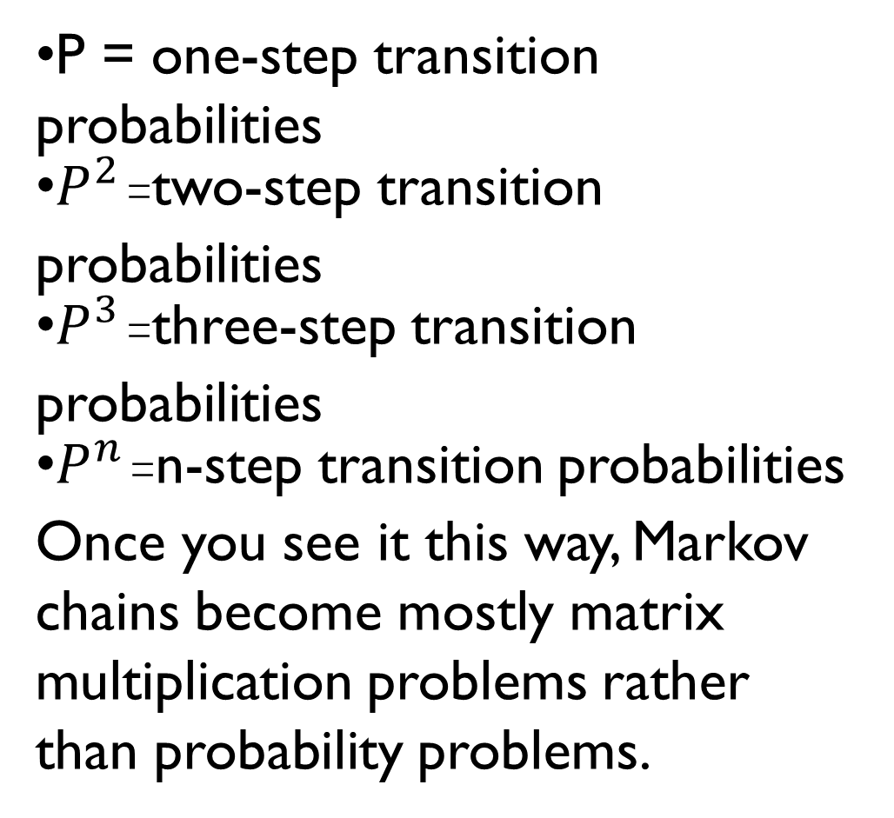
P = one-step transition probabilities
$P^{2}$= two-step transition probabilities
$P^{3}$= three-step transition probabilities
$P^{n}$= n-step transition probabilities
Once you see it this way, Markov chains become mostly matrix multiplication problems rather than probability problems.

Slide 60
Markov Process
Coke vs. Pepsi Example (cont)
Given that a person is currently a Coke purchaser, what is the probability that he will purchase Pepsi three purchases from now?
 | ₌ ⎡0.9 | 0.1⎤⎡0.83 | 0.17⎤ | ₌ ⎡0.781 | 0.219⎤
⎢0.2 |  | 0.8⎥⎢0.34 | 0.66⎥ | ⎢0.438 | 0.562⎥
⎣ |  | ⎦⎣ | ⎦ | ⎣ | ⎦

Slide 61
Thank You

